Slide 1
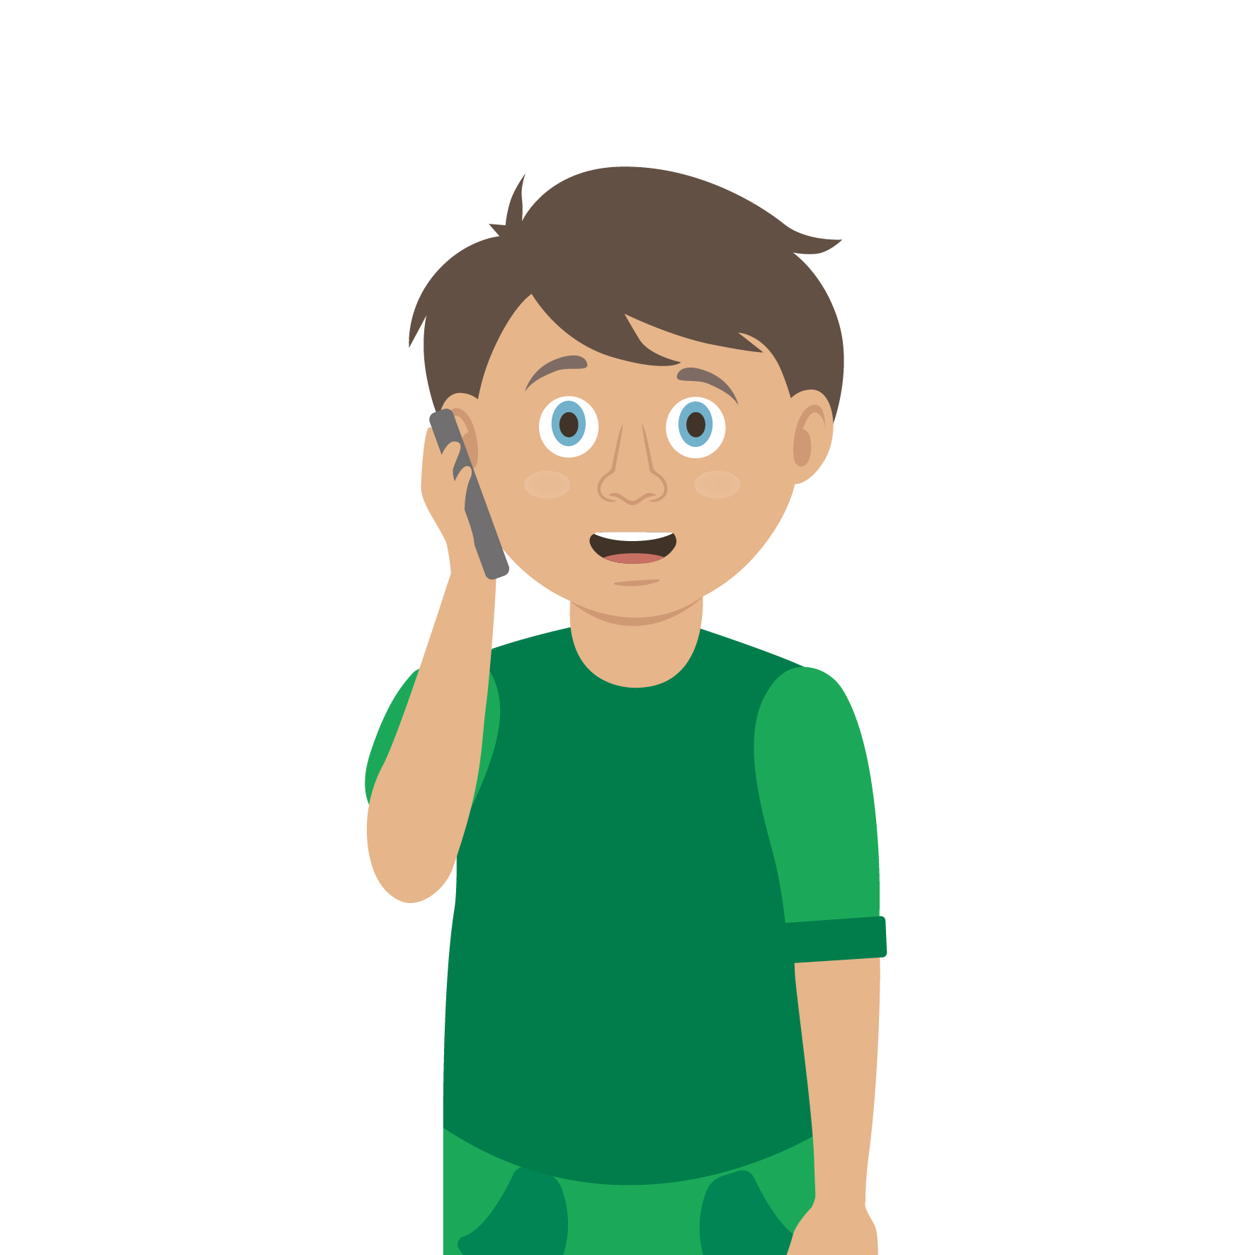
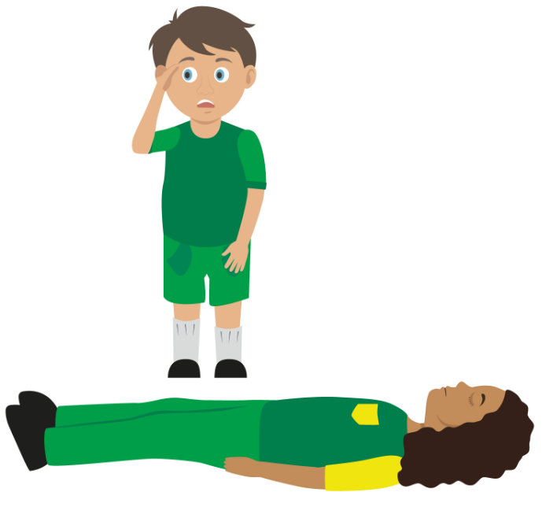
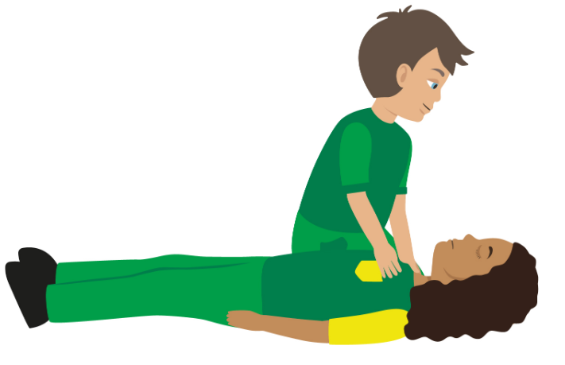
Starter Activity
Calling for help
Number the images to show which step they belong to
Use your current first aid knowledge to explain what you could do for each of the 4 steps.
Step 1.
Step 2.
Step 3.
Step 4.

Slide 2
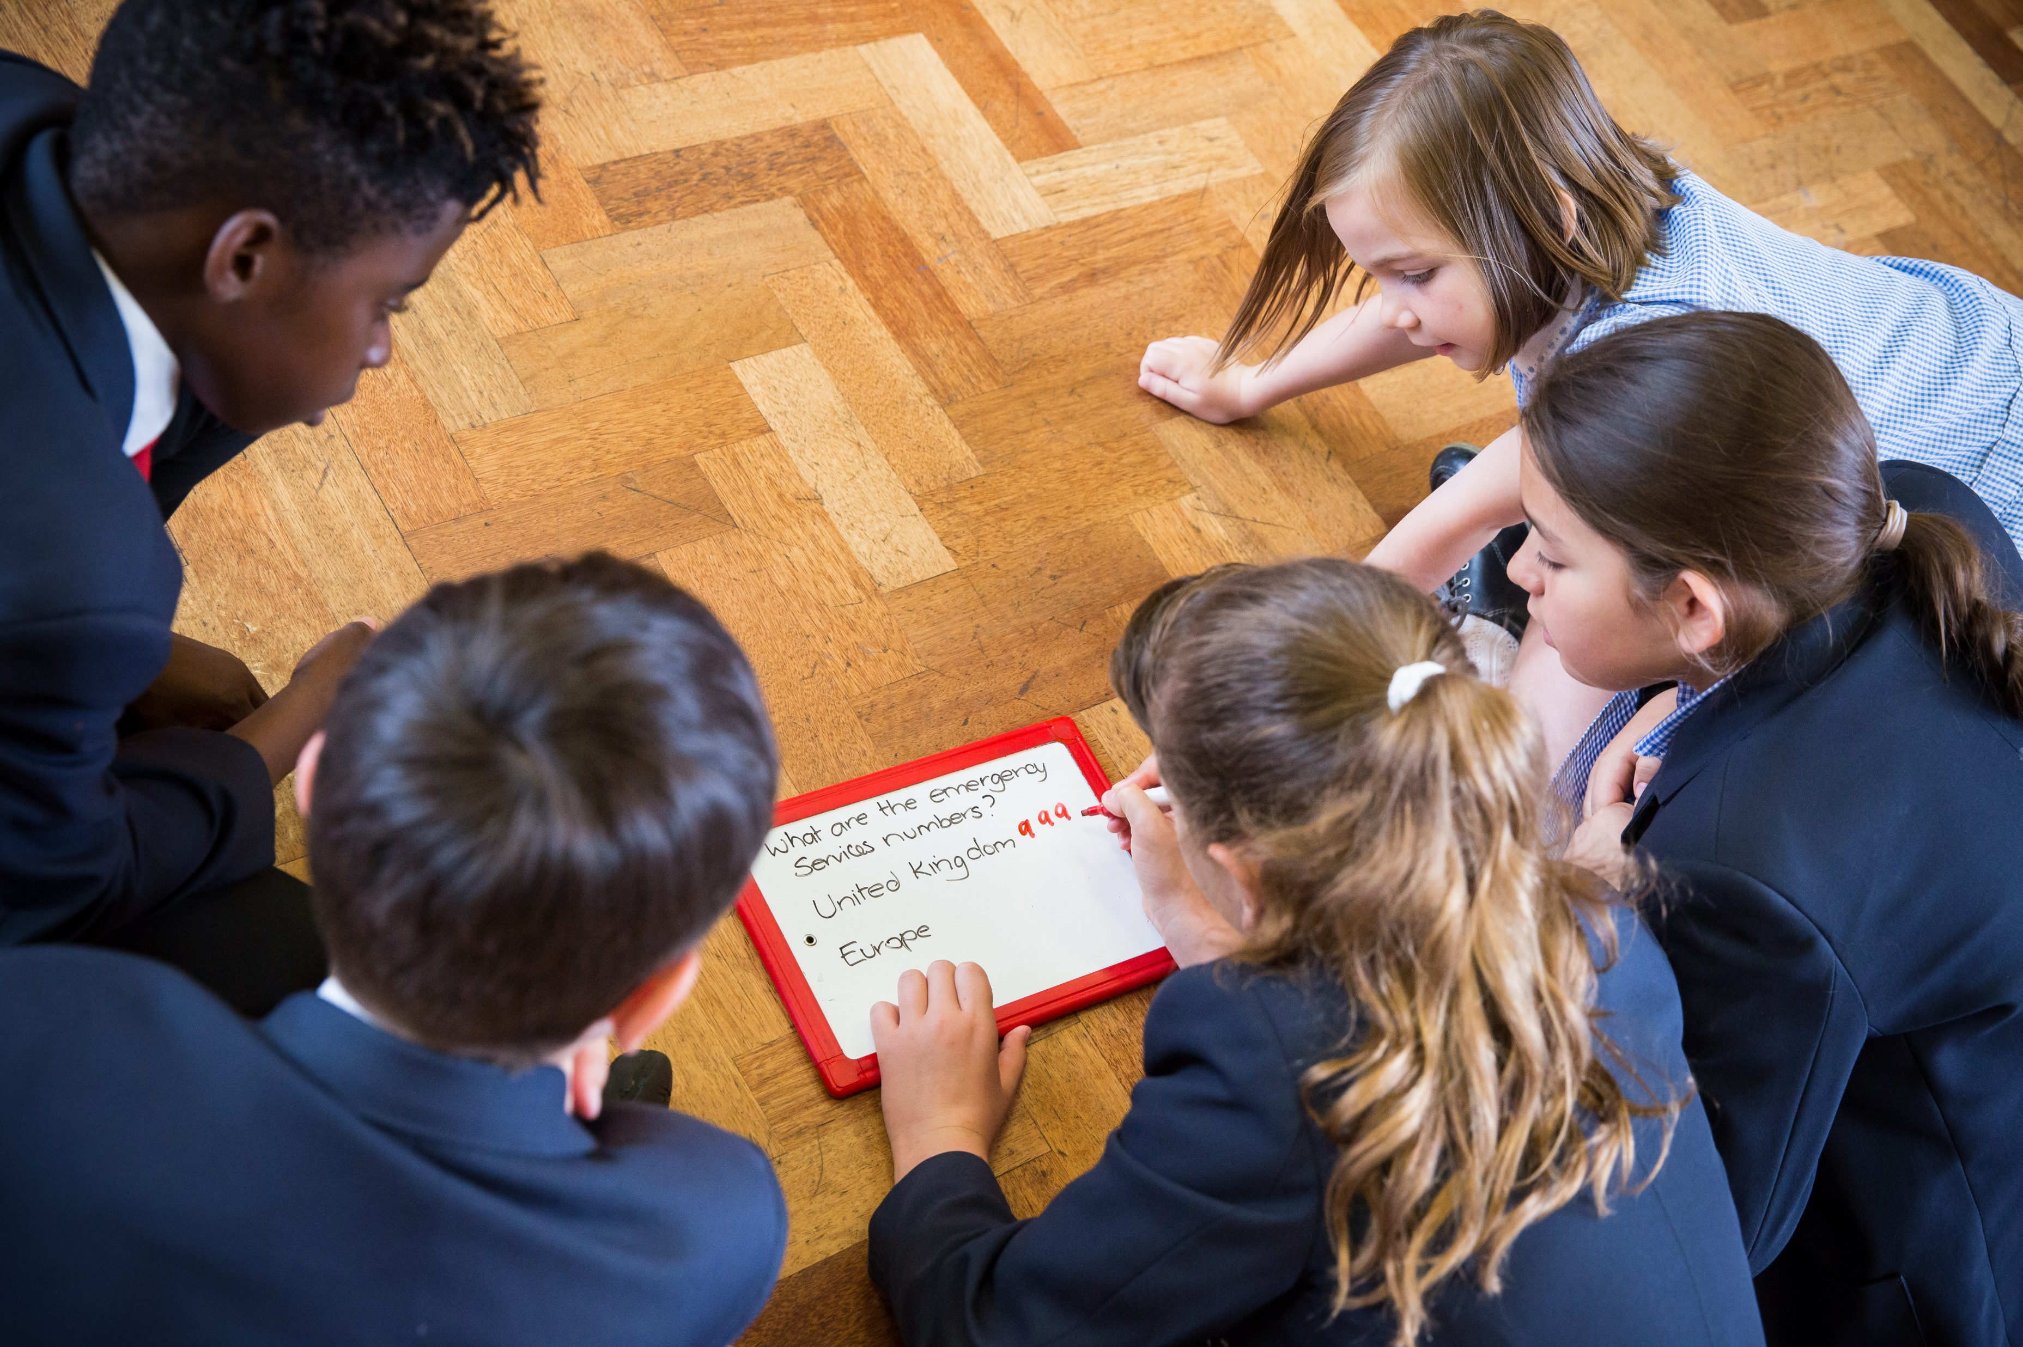


Emergencies
Calling for help
KS2 – Dealing with an emergency

Slide 3

Emergencies and calling for help
Learn what to do and how to call for help if you are faced with an emergency situation.

Slide 4
Learning outcomes
I understand it’s most important to ensure the safety of myself and others in the event of an emergency
I can assist in an emergency by correctly calling for help
I know the information I need to give to emergency services if they are called to an incident
Notes:
Teacher should refer to ground rules for the session at this stage

Slide 5

Keep safe
Basic Rules:
If an accident happens, it is most important that before you do anything else you must ensure that it is safe to approach and offer help.
If anything happens to you then you will be unable to help anyone else. This could mean one casualty then becomes two.

Slide 6
Hazards
What is a hazard?
Put simply, a hazard is a source or a situation which has the potential to cause damage, injury or illness.
Hazards can have an impact on people, property, the environment or a combination of these.
Simply, a hazard is something that could cause harm.
Discussion time
Think of 3 things that could be a hazard.
Discuss your answers.
Notes:
Answers may include:
- An object falling from a height (shelves)
- Tripping on wires/chair legs
- Sharp corners of desks/tables
- Liquids being spilt
Stacked boxes
Electrical equipment not being cared for
Broken equipment/stationary
Shelving/bookcases/cabinets – things may fall if not used properly/cared for

Slide 7
Activity A4
You can now complete activity A4. Students must try to identify hazards in the pictures provided. To complete this activity, please use our downloadable worksheet found on the St John Ambulance website.

Slide 8
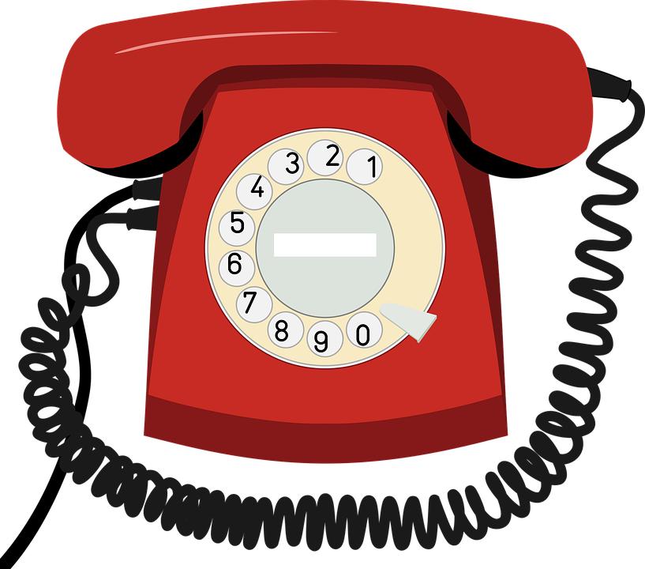

Calling for help
If there is an e_ _ _ _ _ _ _ y you can dial 999 or 112 to get the emergency services.
The call operator will ask, “Which service do you require?
F_ _ _, P_ _ _ _ _ or A_ _ _ _ _ _ _ _?
You will need to tell them which
service you need.
It is really important that you give information to help them arrive at the correct location i.e. address.
Notes:
Emergency
Fire, Police or Ambulance
Reinforce that 999/112 is only to be used In a real emergency. False calls can divert help away from where it is really needed.

Slide 9
Watch this video
https://youtu.be/YOwYPhJfYx4

Slide 10



Remember LIONEL
Location. Tell them where the emergency is and where you want them to arrive.
Incident. Tell them what has happened.
Other services. Do you need more than one?
Number of people that are involved.
Extent of the injuries. What types of injuries do people have?
Location. Repeat again where they need to arrive.
Question:
What is the correct address for two or three places you often visit?

Slide 11
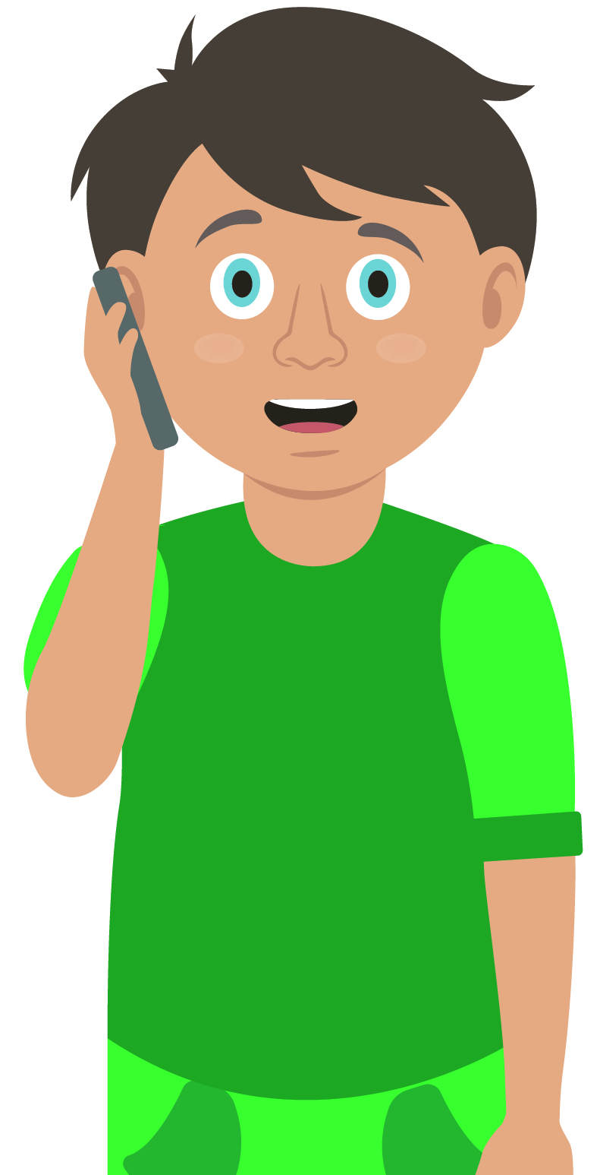

Your turn: Calling for help
1. Check for danger
Always make sure the area is safe
2. Call 999/112
If it is an emergency, call 999 or 112. Remember LIONEL to give them important details.
3. Reassure casualty
Keep casualty reassured
Stay with them until help arrives
  4. If you have been taught any first aid which may be useful, then use it.
Notes:
Scenario cards are available which the teacher can use to make the practical activity relevant in a certain context for students.

Slide 12
Activity A26
You now have the option to complete activity A26. Students should role play and demonstrate how they would deal with each situation. If you wish to complete this activity, please go to slide 18 and use our downloadable worksheet found on the St John Ambulance website.

Slide 13
Activity A27
You now have the option to complete activity A27. This quizzes students on their knowledge of the emergency services and who they should call for help. If you wish to complete this activity, please go to slide 19 and use our downloadable worksheet found on the St John Ambulance website.

Slide 14
Casualty care
Pause for thought...
Which actions do you think are most important when caring for a casualty?
Get help
No food or drink
Prevent condition worsening
Remain calm
Keep warm
Treat with dignity and respect
Reassure casualty
Communicate well
Notes:
Opportunity to discuss common casualty care skills which are necessary in all first aid situations.

Slide 15


Check your learning
I am able to:
Understand it’s most important to ensure the safety of myself and others in the event of an emergency
Assist in an emergency by calling 999/112 for help and asking for the correct service
Use LIONEL to give correct information to the emergency services during an emergency
YES NO

Slide 16

Information and support
If any of the content in this session has upset or concerned you please discuss this with one of the teachers at your school
Further support can be found at:
www.childline.org.uk
www.youngminds.org.uk
www.samaritans.org
Further information linked to first aid can be found at:
www.sja.org.uk
www.asthma.org.uk

Slide 17

Thank you!

Slide 18
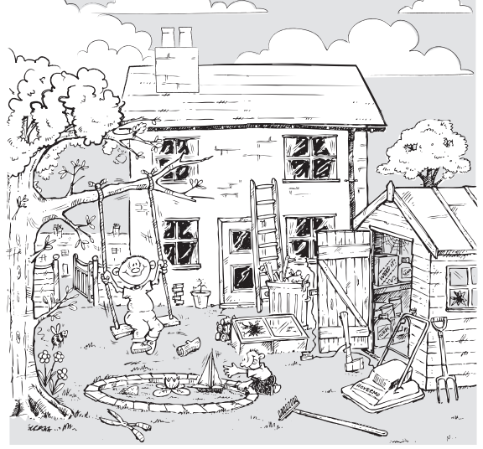
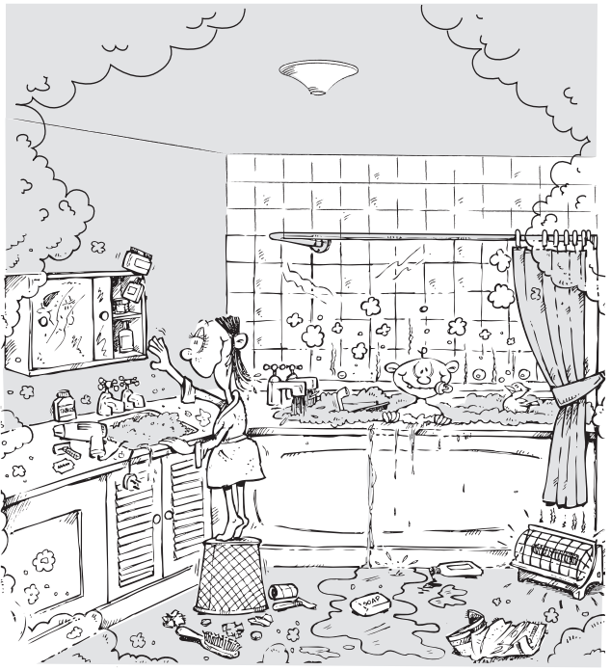
Optional activity
A8
Hazard spotter
Use the worksheets to find and circle as many hazards as you can.
Then explain why each item may be classed as a hazard.

Slide 19
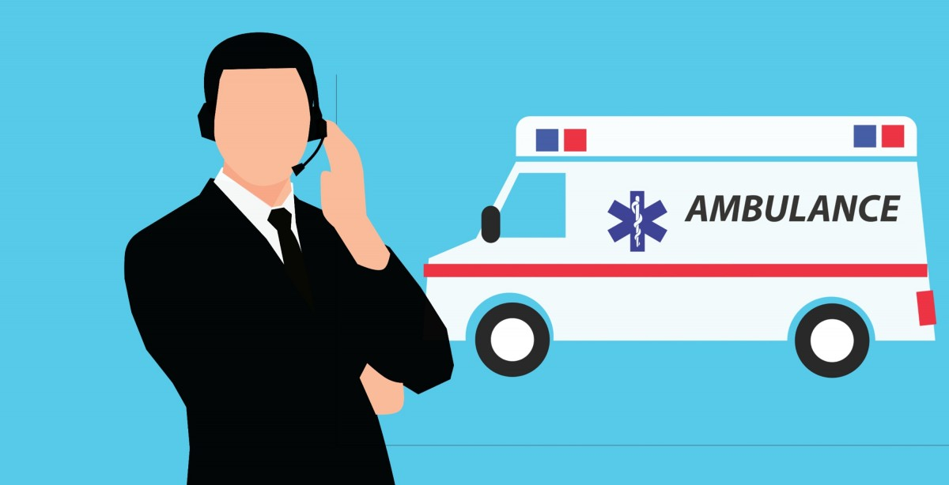
Activity A26
Scenario cards
Select a scenario card and read what has happened.
You must then role play a call for help. Decide which service needs to be sent to the scene of the incident to help. There may be more than one.
Explain your answers.
Use the answers to check if you are correct.
Notes:
Working in pairs/small groups

Slide 20

Activity A27
Emergency services
  Give 2 examples of when you might ask for…
  Fire service
  Ambulance
  Police
  Coastguard
Notes:
Primary fire = buildings, vehicles, fires involving casualties
Secondary fire = fire that are none of the listed above, do not involve casualties
Special services i.e. road traffic incidents, rescuing somebody, major disaster i.e. floods, domestic incidents i.e. water leaks.
Life threatening injuries = loss of consciousness, chest pain, difficulty breathing, severe bleeding
Injuries that cannot be dealt with, without the help of medical care
If a crime is happening right now
If someone is in immediate danger
If there is serious risk to damaging property
A suspect of a serious crime is nearby
If there is a traffic accident
If you or someone else is in trouble in/at sea

